Slide 1
HTML Coding
A Way to Build a Webpage/Website,
a Component of Digital Media

Slide 2
The Internet

Slide 3
A Brief History of the Internet:
Computers were an integral part of World War II. Their adoption as military technology created the first steps into computer networking, creating the first vestiges of the Internet in the late 1960s.
Technology development and the dependence on computers in both academic and business institutions in the 1980s increased public awareness and access to computers generally, and the networks grew slowly until…
1991, when Tim Berners-Lee introduced HTML, the World Wide Web (WWW), and Mosaic (which became Netscape Navigator). The rest is history.

Slide 4
A Brief History of the Internet:
1958: ARPA, the Advanced Research Projects Agency, is
created by the U.S. Defense Department in response
to the 1957 Sputnik launch.
1962: IPTO, the Information Processing Techniques Office, a branch of ARPA, creates the ARPANET, a
minor program designed to stimulate research
in interactive computing.

Slide 5
A Brief History of the Internet:
1983-88: MILNET, the military branch of the internet,
splits off from ARPA-INTERNET for security
purposes. In 1984, the National Science
Foundation starts NSFNET, and by 1990 it replaces the
obsolete ARPANET using the same “backbone”
infrastructure.
1990: The Internet goes private, with a number of Internet
Service Providers (ISPs) being created by business
enterprises, most notably AOL (America Online).

Slide 6
A Brief History of the Internet:
1991: Working at CERN, a high-energy physics lab in
Switzerland, Tim Berners-Lee creates the World
Wide Web, which utilizes Hypertext Markup Language
(html), - Hypertext Transport Protocol (http), and – URLs
(Uniform Resource Locators).
1993- :MOSAIC, the first “web browser”, is created at the Univ. of Illinois, which later becomes Netscape Navigator. Microsoft enters the market late in 1995 with their Internet Explorer browser.

Slide 7
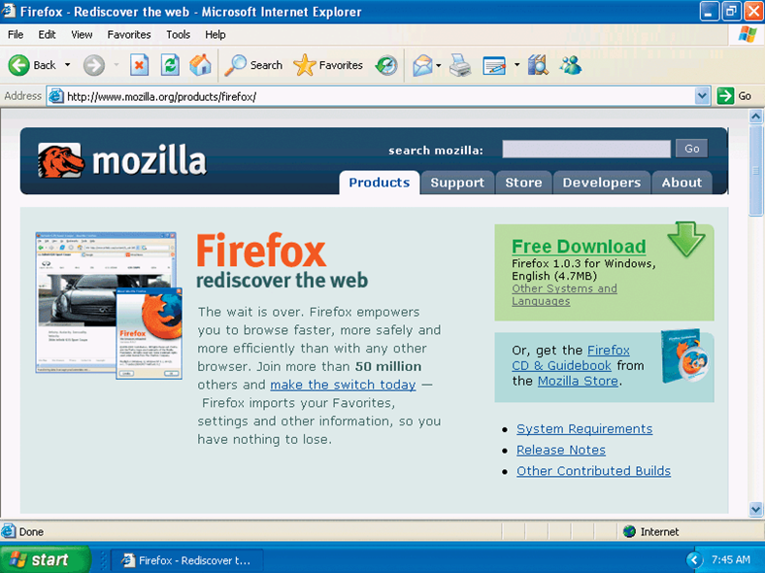
Web Browsers
A Web browser is a specific software program required to display Web pages
Chrome & Internet Explorer

Slide 8
Web Browsers
domain name
protocol
http://pucinfo.calumet.purdue.edu
http://205.216.71.230
protocol
IP address

Slide 9
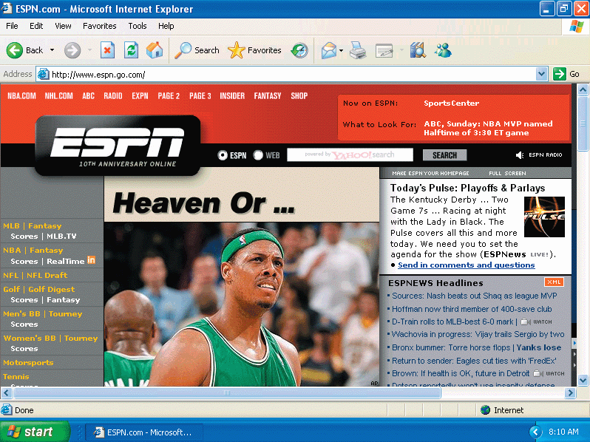
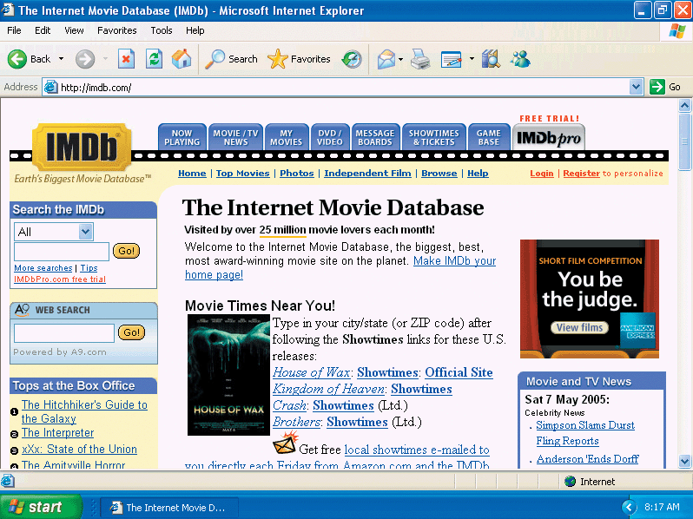
Impact of the Internet and the Web
Communication
Education
Entertainment
Business

Slide 10
Tools for Creating Web Pages
Hypertext Markup Language (HTML)
Uses tags – beginning and end tags.
Tags instruct the computer where and how to display text and images on web pages.
Must use a text editor such as Notepad++
Can use reference materials such W3Schools, to assist in creating and editing code.

Slide 11
Basic HTML Structure
<!DOCTYPE html>
<html>
<body>
<p></p>
<p></p>
<p></p>
</body>
</html>

Slide 12
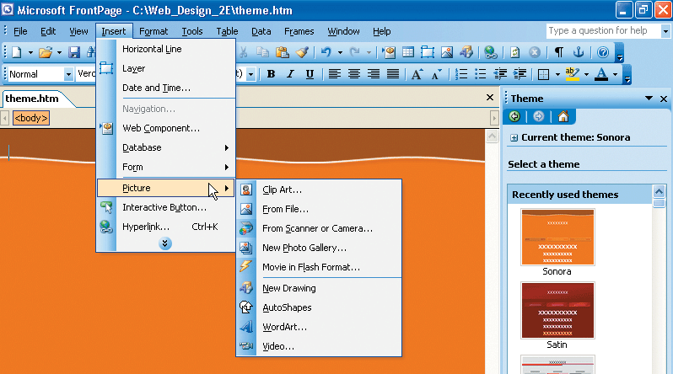
WYSIWYG
Packages that automatically generate HTML code
There are packages available for every level of expertise
Microsoft FrontPage
Macromedia Dreamweaver
Adobe Go Live
Weebly
Wix
Go Daddy
Komposer

